Slide 1
Extending the Terrestrial Observation and Prediction System (TOPS) to Suomi NPP Applications
Forrest Melton
forrest.s.melton@nasa.gov
PI: Rama Nemani
Team: Jennifer Dungan, Sangram Ganguly, Forrest Melton, John Shupe
Ecological Forecasting Lab
NASA Ames Research Center
http://nex.nasa.gov
November 19, 2014
Suomi NPP Applications Workshop, Huntsville, AL

Slide 2
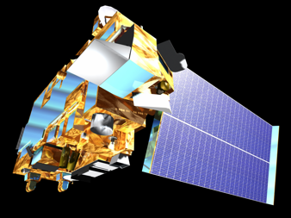

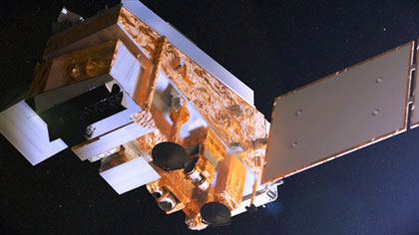

Motivation
Terra MODIS
Continuity and consistency of satellite observations is a primary concern for many Applied Science Program (ASP) projects and their partners
Many Applied Science projects currently rely on MODIS data as inputs to models or Decision Support Systems
Suomi NPP VIIRS
Credit: NASA/Reto Stöckli
Credit: NASA/NOAA/GSFC/Suomi NPP/VIIRS/Norman Kuring

Slide 3
Objectives
Terra MODIS
Understand any errors and uncertainties associated with the transition from MODIS to VIIRS with reference to ASP projects
Integrate Suomi/NPP data and products into existing applications → must address differences in sensor characteristics, algorithms, & data distribution systems
Leverage TOPS and NEX to engage federal, state and local partners in the Suomi-NPP mission by providing a platform for creating high-level products and rapid prototyping of applications
Suomi NPP VIIRS
Credit: NASA/Reto Stöckli
Credit: NASA/NOAA/GSFC/Suomi NPP/VIIRS/Norman Kuring

Slide 4
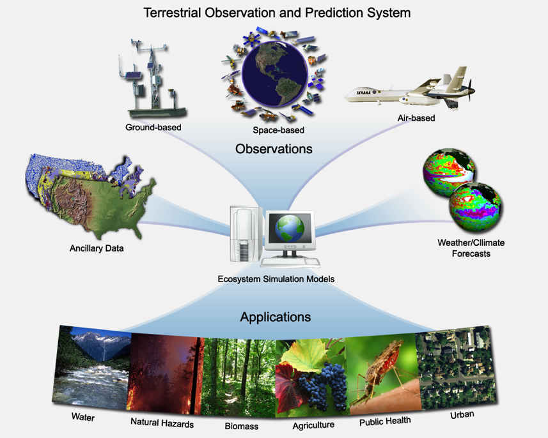
Terrestrial Observation and Prediction System (TOPS)
Partner | Application
NOAA NMFS | Forecasting river temperatures for management of endangered fish species (PI: E Danner, NOAA)
National Park Service / LCCs | Monitoring and forecasting park ecosystem conditions (PI: A Hansen, Montana State Univ.)
CA Dept. of Water Resources / Western Growers | Mapping crop canopy conditions and crop water requirements (PI: F Melton, NASA Ames / ARC-CREST)
USGS / USDA / CA DWR | Mapping fallow area extent (PI: J Verdin, USGS)

Slide 5
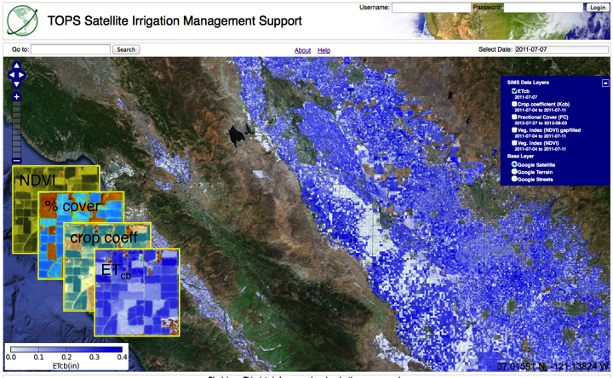
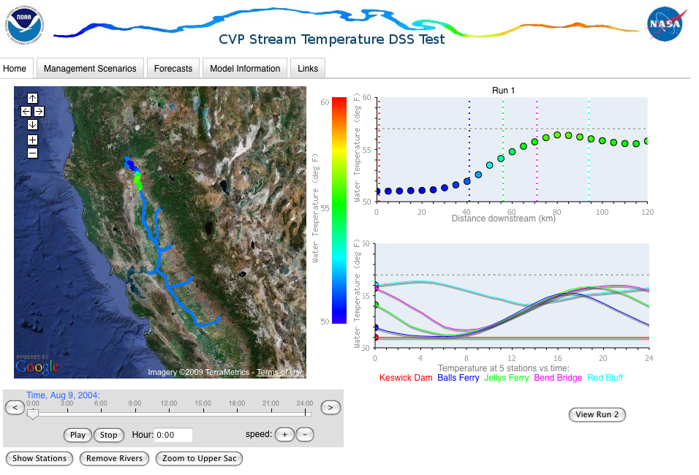
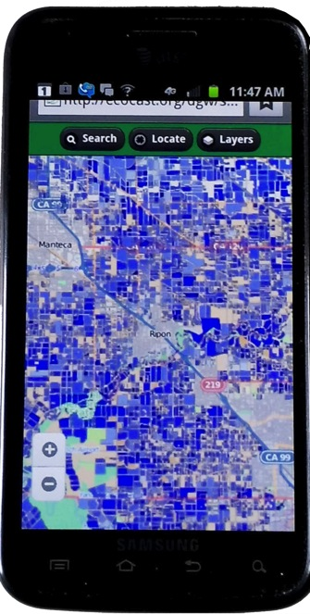
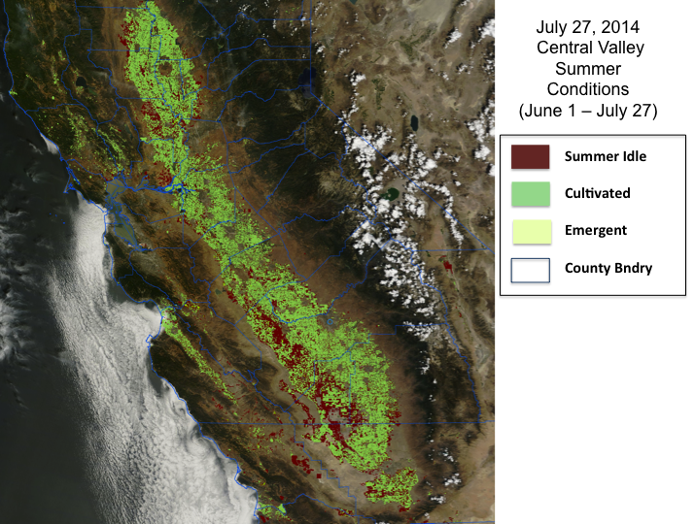
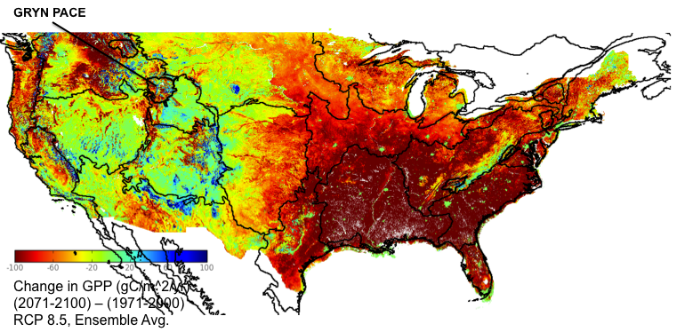
TOPS Applications
Mapping Crop Water Requirements (CDWR)
Forecasting Stream Temperatures (NMFS)
Drought Impacts on Ag (USDA, USGS)
Monitoring Ecosystem Conditions (NPS)

Slide 6
Project Workflow
NEX
Datapool
VIIRS Data Acquisition
Compare MODIS & VIIRS Surface Reflectance Product values
MODIS Climatology/Anomaly Workflow Engine
VIIRS Climatologies/
Anomalies
LAI/FPAR based on both MODIS and VIIRS
TOPS
VIIRS-
Derived Products
MODIS- Derived Products
GPP, ET, SOIL MOISTURE
Ancillary Data
Verification/ Validation

Slide 7
MODIS-VIIRS Transition Issues
Spectral characteristics:
MODIS and VIIRS bands used for land products have similar spectral characteristics
Tungsten oxide contamination was a potential problem for VIIRS bands I2 and M7
Spatial characteristics:
Improved spatial resolution at swath edge for VIIRS vs. MODIS
375m vs. 250m resolution limits utility for some ag & ecosystem monitoring applications
Algorithms:
Algorithm changes from MODIS to VIIRS for some standard products (e.g., TOA vs TOC NDVI)
Different data formats
Data processing and distribution:
MODIS data pool vs. NOAA CLASS
Lack of reprocessing of standard products may limit VIIRS utility for detection of anomalies / long-term trends
VIIRS vs. MODIS Corresponding Spectral Bands
VIIRS Band | Spectral Range (μm) | Nadir HSR (m) | MODIS Band(s) | Spectral Range (μm) | Nadir HSR (m)
DNB | 0.500 – 0.900
M1 | 0.402 – 0.422 | 750 | 8 | 0.405 – 0.420 | 1000
M2 | 0.436 – 0.454 | 750 | 9 | 0.438 – 0.448 | 1000
M3 | 0.478 – 0.498 | 750 | 3 10 | 0.459 – 0.479 0.483 – 0.493 | 500 10000
M4 | 0.545 – 0.565 | 750 | 4 12 | 0.545 – 0.565 0.546 – 0.556 | 500 1000
I1 | 0.600 – 0.680 | 375 | 1 | 0.620 – 0.670 | 250
M5 | 0.662 – 0.682 | 750 | 13 14 | 0.662 – 0.672 0.673 – 0.683 | 1000 1000
M6 | 0.739 – 0.754 | 750 | 15 | 0.743 – 0.753 | 1000
I2 | 0.846 – 0.885 | 375 | 2 | 0.841 – 0.876 | 250
M7 | 0.846 – 0.885 | 750 | 16 2 | 0.862 – 0.877 0.841 – 0.876 | 1000 250
M8 | 1.230 – 1.250 | 750 | 5 | SAME | 500
M9 | 1.371 – 1.386 | 750 | 26 | 1.360 – 1.390 | 1000
I3 | 1.580 – 1.640 | 375 | 6 | 1.628 – 1.652 | 500
M10 | 1.580 – 1.640 | 750 | 6 | 1.628 – 1.652 | 500
M11 | 2.225 – 2.275 | 750 | 7 | 2.105 – 2.155 | 500
I4 | 3.550 – 3.930 | 375 | 20 | 3.660 – 3.840 | 1000
M12 | 3.660 – 3.840 | 750 | 20 | SAME | 1000
M13 | 3.973 – 4.128 | 750 | 21 22 | 3.929 – 3.989 3.929 – 3.989 | 1000 1000
M14 | 8.400 – 8.700 | 750 | 29 | SAME | 1000
M15 | 10.263 -- 11.263 | 750 | 31 | 10.780 – 11.280 | 1000
I5 | 10.500 – 12.400 | 375 | 31 32 | 10.780 – 11.280 11.770 – 12.270 | 1000 1000
M16 | 11.538 – 12.488 | 750 | 32 | 11.770 – 12.270 | 1000

Slide 8
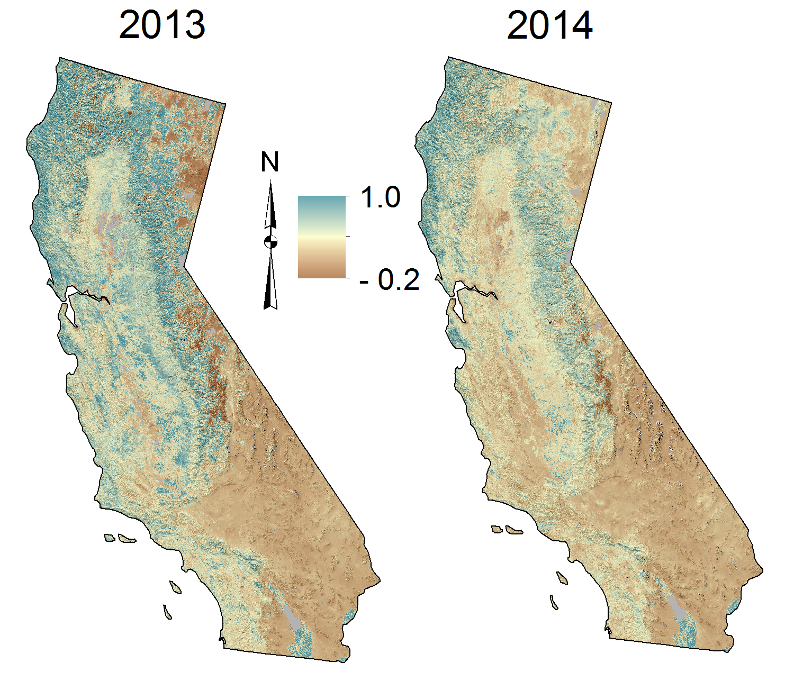
VIIRS Products from the Land PEATE
VIIRS top-of-canopy Enhanced Vegetation Index (EVI), 16-day composite, first 2 weeks in January
Notes:
Still “beta” version
VIIRS products from the Land PEATE are converging with MODIS products and are now available in HDF4 from LAADS (“beta” readiness status)
There are no daily vegetation index products yet available from LAADS
Funding from ROSES-13 will be supporting SIPS to generate MODIS-compatible VIIRS products

Slide 9
Aqua MODIS EVI vs VIIRS EVI

Slide 10
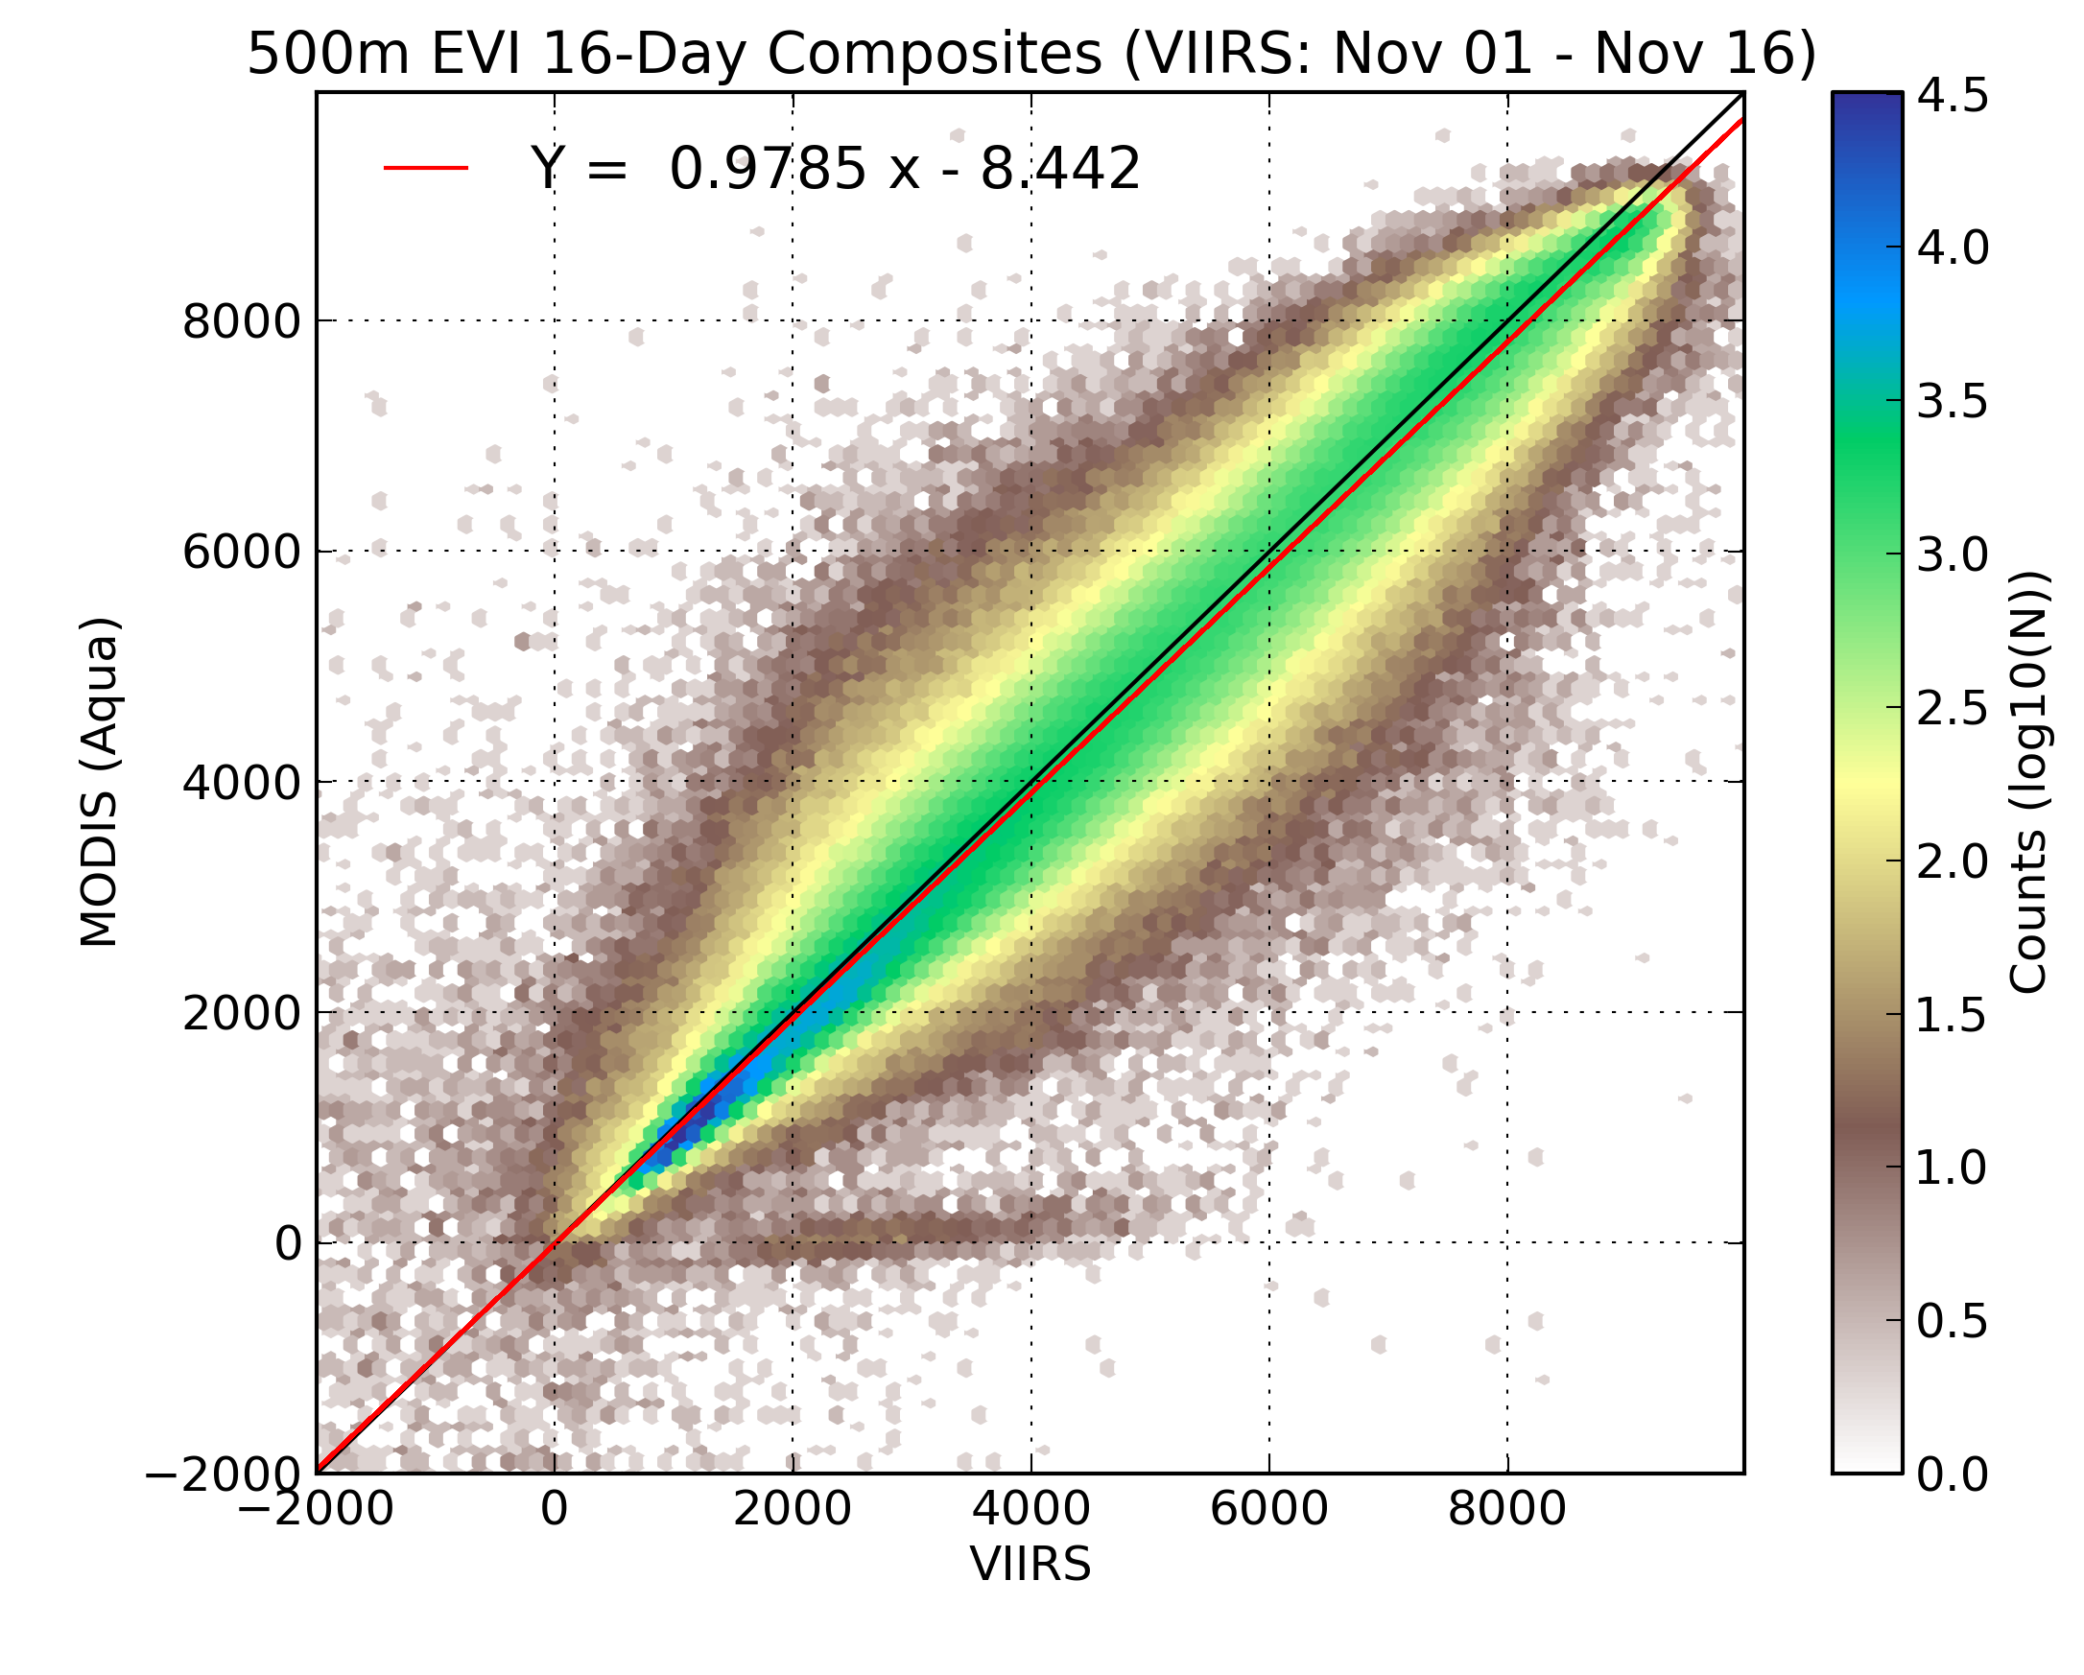

Slide 11
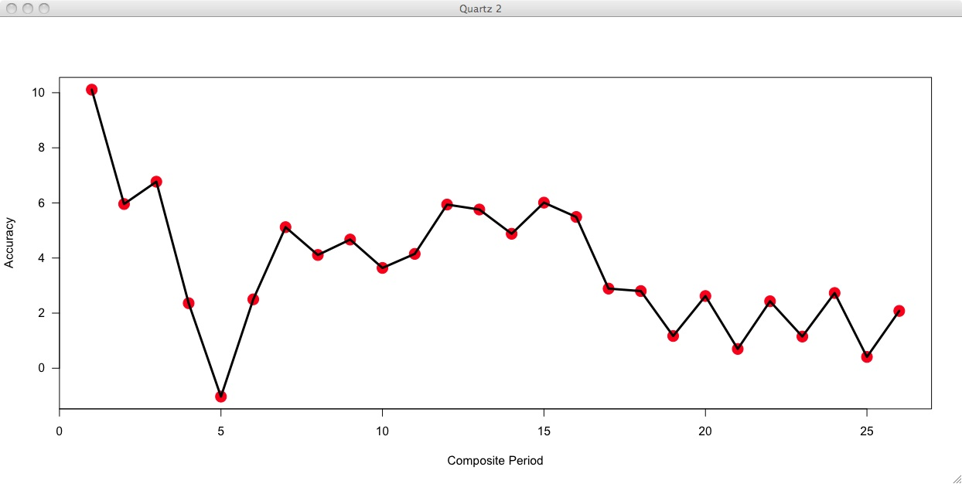
Accuracy
Bias statistics for 500m, 16-day TOC EVI adjusted Land PEATE product relative to Aqua MODIS
Composite Period

Slide 12
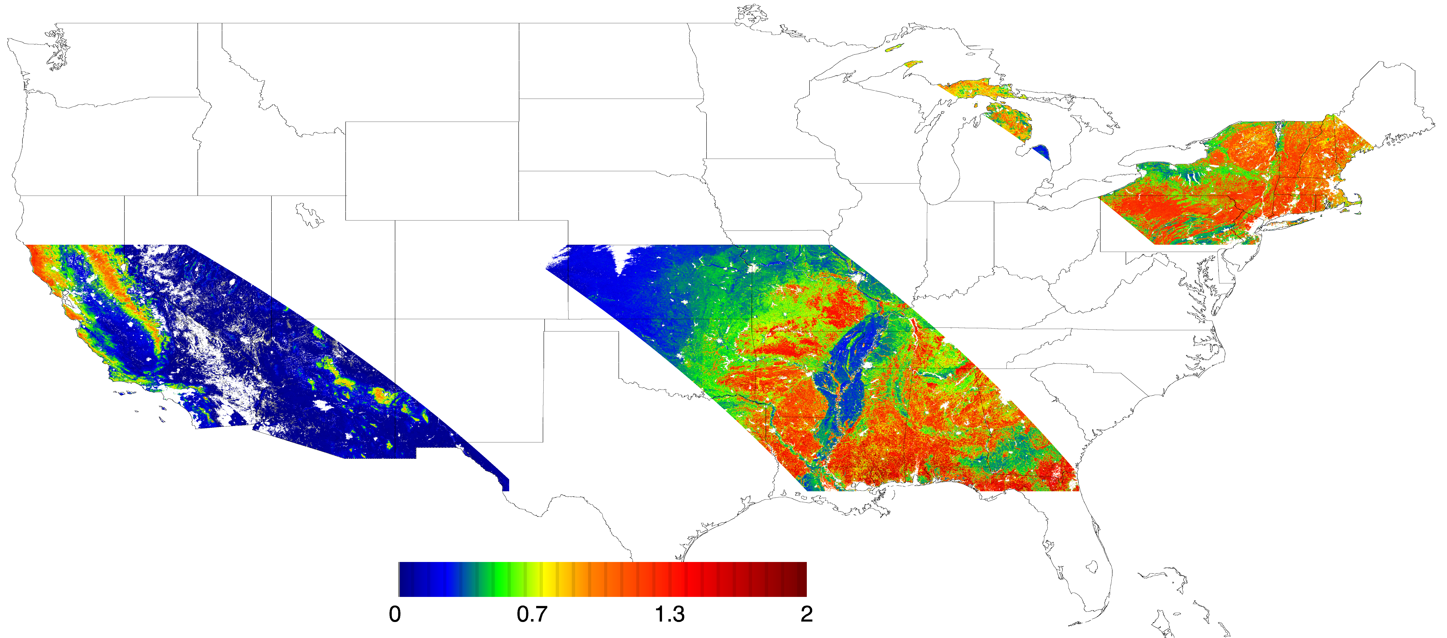
TOPS-Generated Gross Primary Production (GPP) in 2012
kgC/m²/year
Notes:
The EVI was obtained directly from Dr. Miura who is on the Science Team.

Slide 13
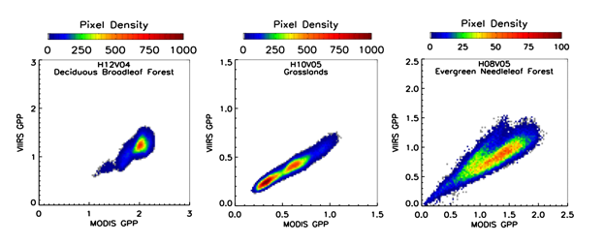
MODIS/VIIRS Comparison for GPP

Slide 14
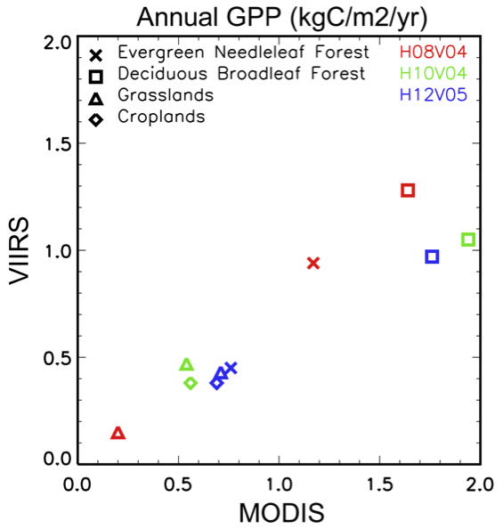
Annual GPP (kg C/m²/year)

Slide 15
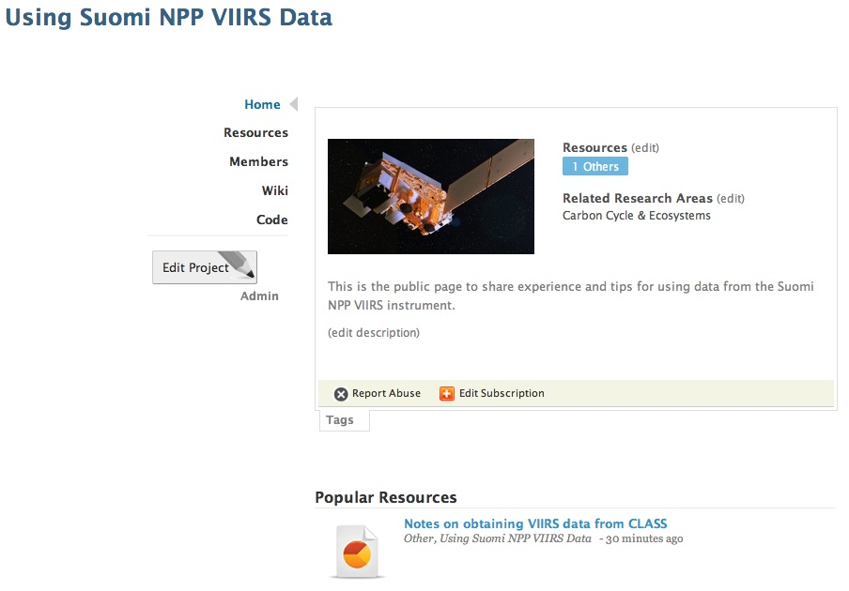
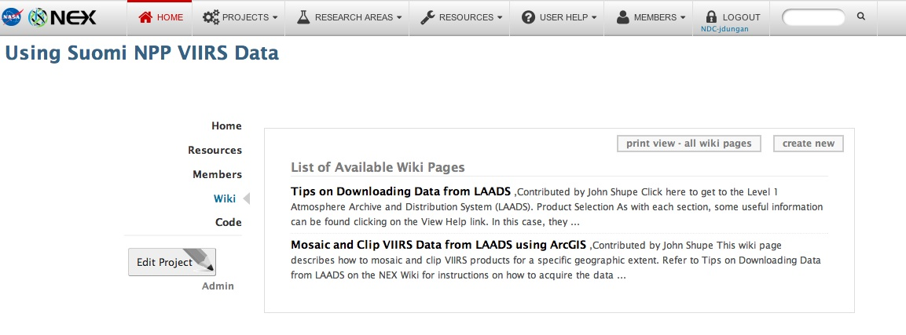
Sharing Experience on the NEX Portal
https://nex.nasa.gov/nex/projects/1354/

Slide 16
Summary
Substantial progress on support for MODIS-VIIRS transition for NASA ASP projects thanks to work by Land-PEATE / SIPS
Differences between MODIS and VIIRS L2 / L3 products remain
Differences can vary over time and cascade through applications to derived products
Important to conduct assessment of MODIS-VIIRS transition prior to integration of VIIRS into applications
Need for additional tools / resources to facilitate comparisons and corrections across applications

